Slide 1
letters
boxes
A B C D wadawthth

Slide 2
12345
A
B
C
D
E

Slide 3
1.11.21.31.4
A
B
A
C
A
D
A
E

Slide 4
2.12.22.32.4
B
A
B
C
B
D
B
E

Slide 5
3.13.23.33.4
C
A
C
B
C
D
C
E

Slide 6
4.14.24.34.4
D
A
D
B
D
C
D
E

Slide 7
5.15.25.35.4
E
A
E
B
E
C
E
D

Slide 8


$$C\left(n,k\right)=\frac{P\left(n,k\right)}{k!}$$
$$C\left(n,k\right)=\frac{n!}{k!∗(n−k)!}$$

Slide 9

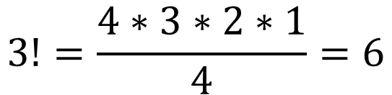



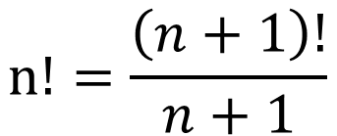
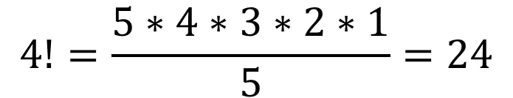
$$5!=5∗4∗3∗2∗1=120$$
$$n!=\frac{\left(n+1\right)!}{n+1}$$
$$3!=\frac{4∗3∗2∗1}{4}=6$$
$$4!=\frac{5∗4∗3∗2∗1}{5}=24$$
$$0!=\frac{1!}{1}=1$$
$$2!=\frac{3!}{3}=2$$
$$1!=\frac{2!}{2}=1$$

Slide 10
A B C A C B C A B C B A B C A B A C a
A B D A D B
D A B D B A B A D B D A a
B D C B C D C B D C D B D B C D C B a
D C A D A C A C D A D C
C A D C D A a

Slide 11
* 24 permutations
There are only 4 combinations, the rest don’t count since they are only a replica (in terms of combinations) of this row.
A B C | A B D | A C D | B C D
A C B | A D B | A D C | B D C
B A C | B A D | D C A | D C B
B C A | B D A | D A C | D B C
C A B | D A B | C A D | C B D
C B A | D B A | C D A | C D B

Slide 12
* 12 permutations
2! ways to arrange two letters
A B | C B | A C | D A | D B | D C
B A | B C | C A | A D | B D | C D
A B | C B | A C | D A | D B | D C

